Slide 1

Crypto currency

Slide 2

What is it?
Digital asset designed to work as a medium of exchange.
Strong cryptography to secure transaction records.
Does not exist in physical form.
Use decentralized control .
each cryptocurrency works through distributed ledger technology, typically a blockchain, that serves as a public financial transaction database.

Slide 3

History
1983
In 1983, the American cryptographer David Chaum conceived an anonymous cryptographic electronic money called ecash.
1995
Later, in 1995, he implemented it through Digicash.
1996
In 1996, the National Security Agency published a paper entitled How to Make a Mint: the Cryptography of Anonymous Electronic Cash,
2009
The first decentralized cryptocurrency, bitcoin, was created in 2009 by ‘{ Satoshi Nakamoto }'.

Slide 4
Mining
mining is a validation of transactions.
creating a complementary incentive to contribute to the processing power of the network.
GPU evolution
Wallets
A cryptocurrency wallet stores the public and private "keys" or "addresses"
double-edged sword -> Anonymity

Slide 5
Economics
Cryptocurrencies are used primarily outside existing banking and governmental institutions and are exchanged over the Internet.

Slide 6
BlockChain
Blockchain is a specific type of database.blockchains store data in blocks that are then chained together.
As new data comes in it is entered into a fresh block.
Once the block is filled with data it is chained onto the previous block, which makes the data chained together in chronological order.

Slide 7
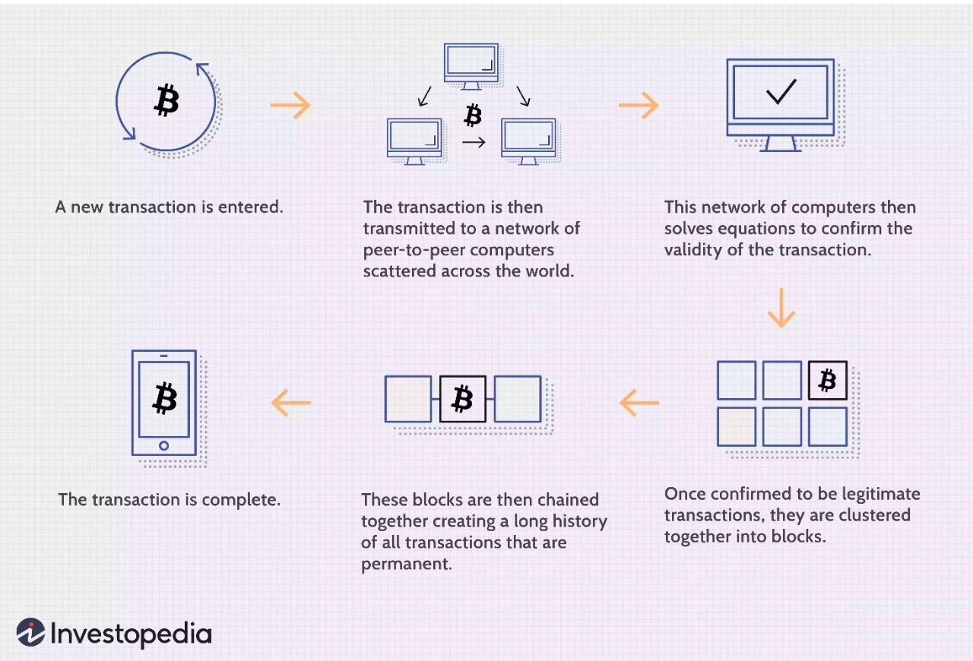
Transaction process

